Slide 1

Moment-based Opacity Optimization
M. Zeidan, T. Rapp, C. Peters, and C. Dachsbacher
Computer Graphics Group
Karlsruhe Institute of Technology (KIT)
Notes:
Welcome everyone and thanks for being here
So today I will present our work on moments-based opacity optimization

Slide 2
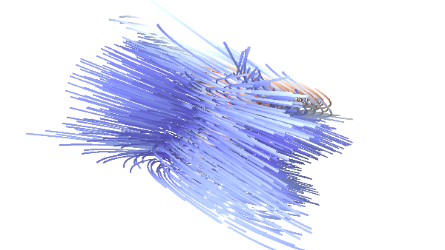
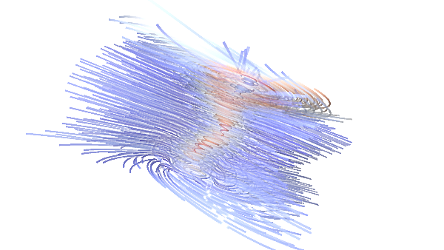
Opacity Optimization (OO)
Notes:
First I would like to explain the motivation behind our work
So, OO is a visualization techniques which is used to highlight important structures and reduces visual clutter within dense geometry
As you can see here, by using opacity optimization we are able to see the internal vortex structure of the tornado data set.
In gneral OO assign opacity for rendered fragments in order to remove foreground and background clutter around important structures

Slide 3
Moment-based Opacity Optimization (MBOO)
Motivation and Contributions
Novel technique for opacity optimization using moments
Efficient and fast filtering method for optimized opacities
Evaluate our technique against state of the art solutions
Notes:
This brings us to our main contributions in this work
First, we present a novel approach for opacity optimization based on recent state-of-the-art moment-based techniques for signal reconstruction
Second, we present a fast screen space filtering approach for optimized opacities
And finally, we compare our technique to recent state of the art techniques for opacity optimization on several datasets
Before I explain our technique, I would like to briefly discuss some of closely related work on opacity optimization

Slide 4
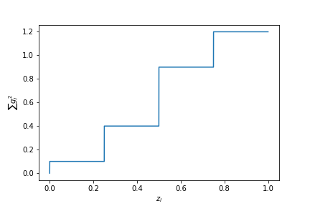
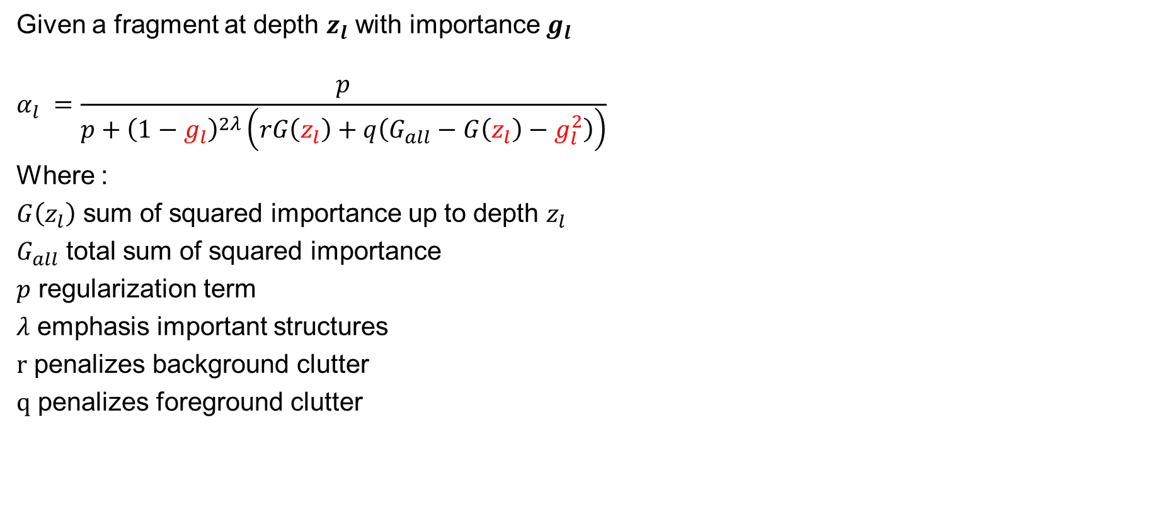
Decoupled Opacity Optimization (DOO) [GTG17]
Given a fragment at depth $z_{l}$ with importance $g_{l}$
$$α_{l} =\frac{p}{p+{\left(1−g_{l}\right)}^{2λ}\left(rG\left(z_{l}\right)+q\left(G_{all}−G\left(z_{l}\right)−g_{l}^{2}\right)\right)}$$
Where :
$G\left(z_{l}\right)$ sum of squared importance up to depth $z_{l}$
$G_{all}$ total sum of squared importance
$p$ regularization term
$λ$ emphasis important structures
$r$ penalizes background clutter
$q$ penalizes foreground clutter
Notes:
In the beginning I would like to talk about DOO
Decoupled Opacity optimization is least square minimization problem
Using the analytic solution of this problem, we can find the optimized opacity value for each rendered fragment along the view ray
Let me explain the optimization process in more details
If we look at this figure; and given a list of fragments along the view ray
Each fragment is assigned an input importance value g_l
This, importance value ranges from 0 to 1, and represent how important a certain geometric segment in the overall context of the data
Then for each render fragment at certain depth, we find the optimized opacity value using this formula
Since this formula represents the basis of our work, I will explain each term separately in the next slides

Slide 5
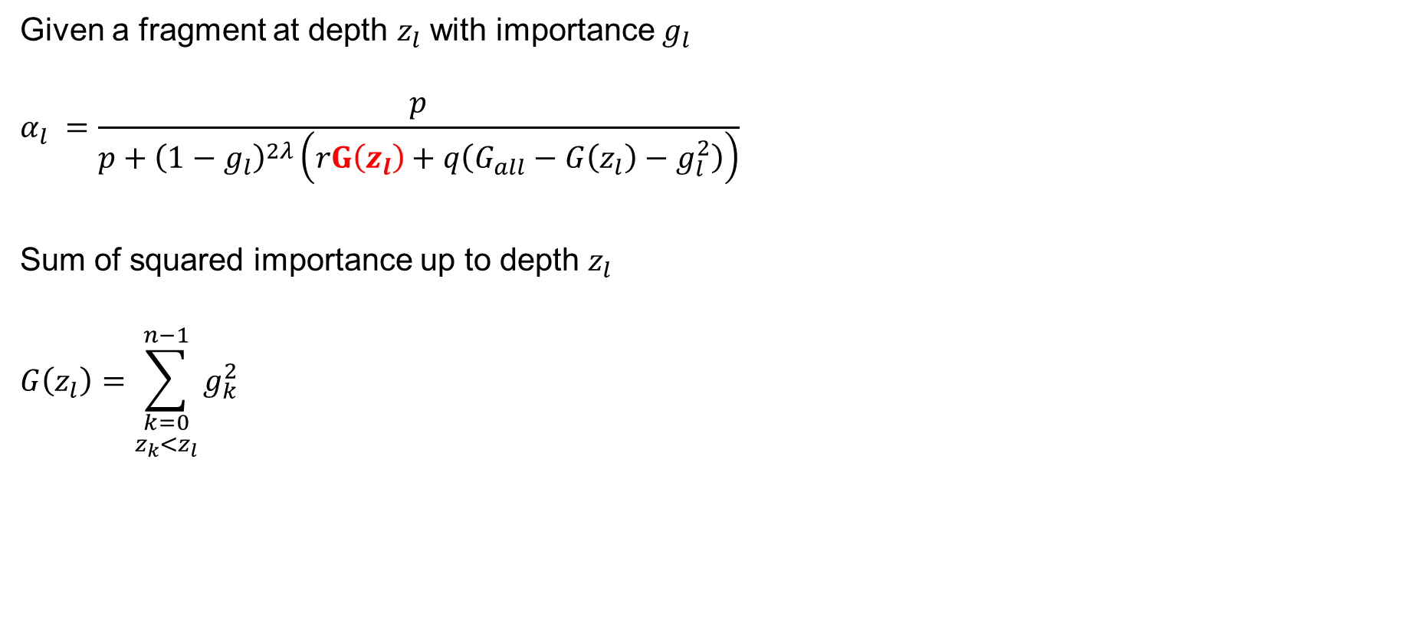
Decoupled Opacity Optimization (DOO) [GTG17]
Given a fragment at depth $z_{l}$ with importance $g_{l}$
$$α_{l} =\frac{p}{p+{\left(1−g_{l}\right)}^{2λ}\left(rG\left(z_{l}\right)+q\left(G_{all}−G\left(z_{l}\right)−g_{l}^{2}\right)\right)}$$
Sum of squared importance up to depth $z_{l}$
$$G\left(z_{l}\right)=\sum_{\begin{aligned}k=0 \\ z_{k}<z_{l}\end{aligned}}^{n−1}{g_{k}^{2}}$$
Notes:
The first term we want to highlight represents the accumulated squared importance up certain fragment depth
this term is an important measure of the geometric structures in front of the current fragment
As show in this figure we display simplified view of accumulated importance of 4 rendered fragments

Slide 6
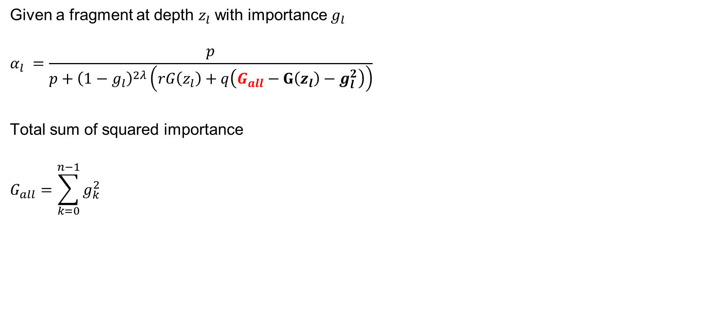
Decoupled Opacity Optimization (DOO)
Given a fragment at depth $z_{l}$ with importance $g_{l}$
$$α_{l} =\frac{p}{p+{\left(1−g_{l}\right)}^{2λ}\left(rG\left(z_{l}\right)+q\left(G_{all}−G\left(z_{l}\right)−g_{l}^{2}\right)\right)}$$
Total sum of squared importance
$$G_{all}=\sum_{k=0}^{n−1}{g_{k}^{2}}$$
Notes:
The next term we want to highlight is the total sum of squared importance along the view ray
By subtraction the accumulated importance up to certain depth form the total importance we have a representative measure of the geometric structures behind the current fragment

Slide 7
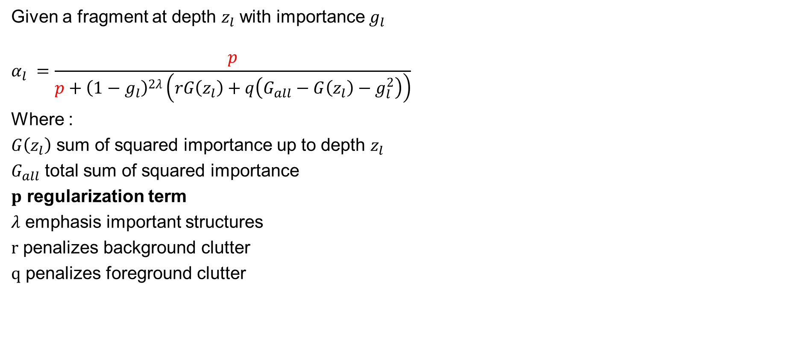
Decoupled Opacity Optimization (DOO)
Given a fragment at depth $z_{l}$ with importance $g_{l}$
$$α_{l} =\frac{p}{p+{\left(1−g_{l}\right)}^{2λ}\left(rG\left(z_{l}\right)+q\left(G_{all}−G\left(z_{l}\right)−g_{l}^{2}\right)\right)}$$
Where :
$G\left(z_{l}\right)$ sum of squared importance up to depth $z_{l}$
$G_{all}$ total sum of squared importance
$p$ regularization term
$λ$ emphasis important structures
$r$ penalizes background clutter
$q$ penalizes foreground clutter
Notes:
In this equation we also have 4 user control parameters
The 1st parameter, is a regularization term for the optimization process and is used to prevent empty rendering

Slide 8
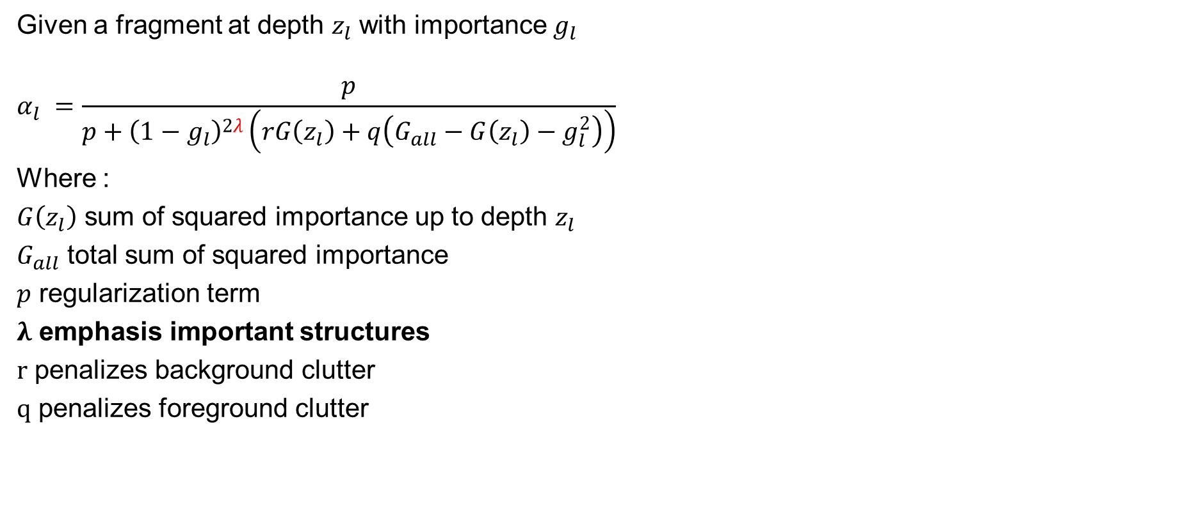
Decoupled Opacity Optimization (DOO)
Given a fragment at depth $z_{l}$ with importance $g_{l}$
$$α_{l} =\frac{p}{p+{\left(1−g_{l}\right)}^{2λ}\left(rG\left(z_{l}\right)+q\left(G_{all}−G\left(z_{l}\right)−g_{l}^{2}\right)\right)}$$
Where :
$G\left(z_{l}\right)$ sum of squared importance up to depth $z_{l}$
$G_{all}$ total sum of squared importance
$p$ regularization term
$λ$ emphasis important structures
$r$ penalizes background clutter
$q$ penalizes foreground clutter
Notes:
The 2ed parameter: let us emphasis important structure and put more focus on them

Slide 9
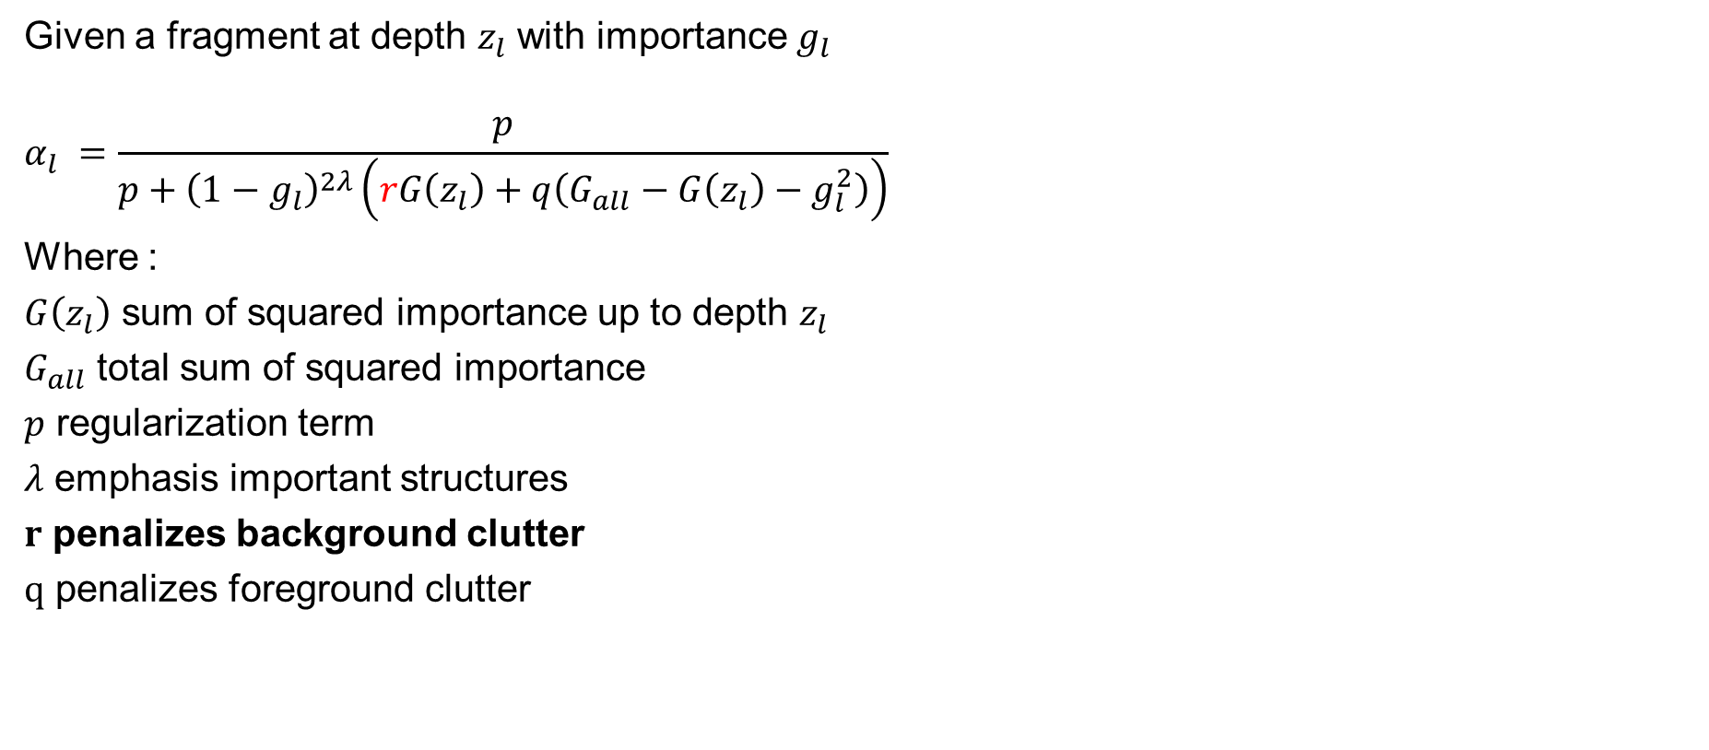
Decoupled Opacity Optimization (DOO)
Given a fragment at depth $z_{l}$ with importance $g_{l}$
$$α_{l} =\frac{p}{p+{\left(1−g_{l}\right)}^{2λ}\left(rG\left(z_{l}\right)+q\left(G_{all}−G\left(z_{l}\right)−g_{l}^{2}\right)\right)}$$
Where :
$G\left(z_{l}\right)$ sum of squared importance up to depth $z_{l}$
$G_{all}$ total sum of squared importance
$p$ regularization term
$λ$ emphasis important structures
$r$ penalizes background clutter
$q$ penalizes foreground clutter
Notes:
The 3rd parameter: is used to penalize background clutter

Slide 10
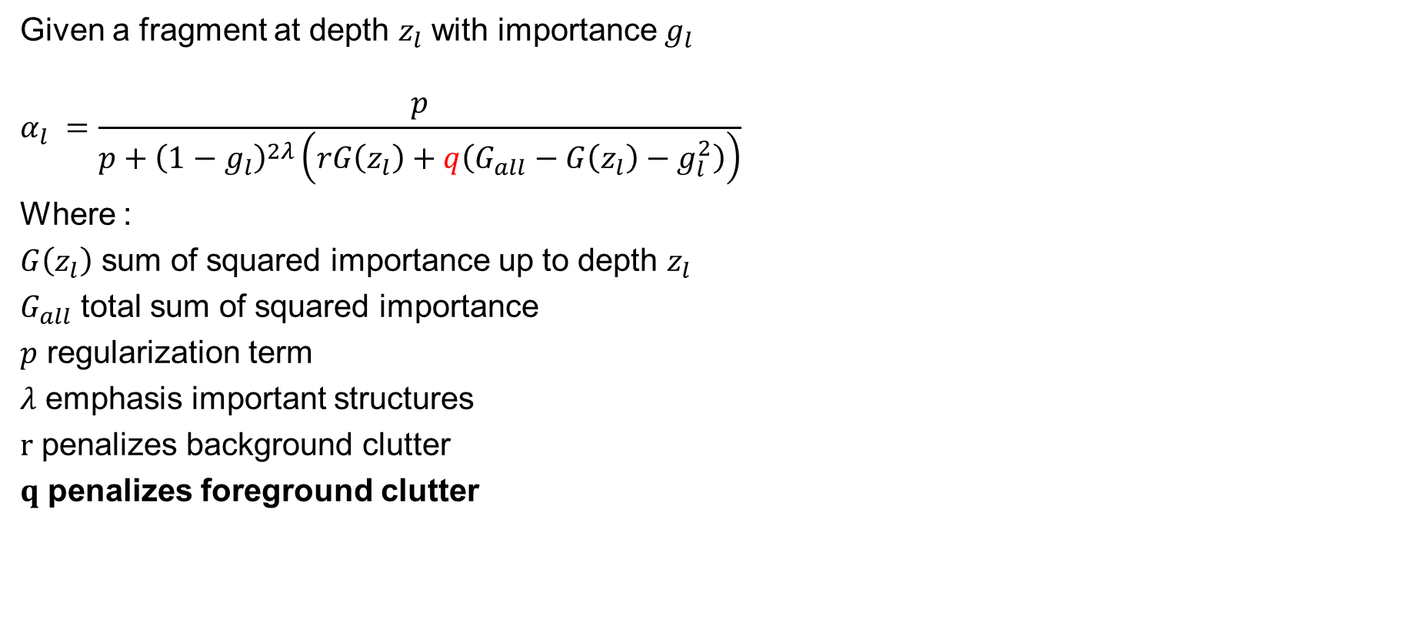
Decoupled Opacity Optimization (DOO)
Given a fragment at depth $z_{l}$ with importance $g_{l}$
$$α_{l} =\frac{p}{p+{\left(1−g_{l}\right)}^{2λ}\left(rG\left(z_{l}\right)+q\left(G_{all}−G\left(z_{l}\right)−g_{l}^{2}\right)\right)}$$
Where :
$G\left(z_{l}\right)$ sum of squared importance up to depth $z_{l}$
$G_{all}$ total sum of squared importance
$p$ regularization term
$λ$ emphasis important structures
$r$ penalizes background clutter
$q$ penalizes foreground clutter
Notes:
And the 4th parameter: is used to penalize foreground clutter

Slide 11
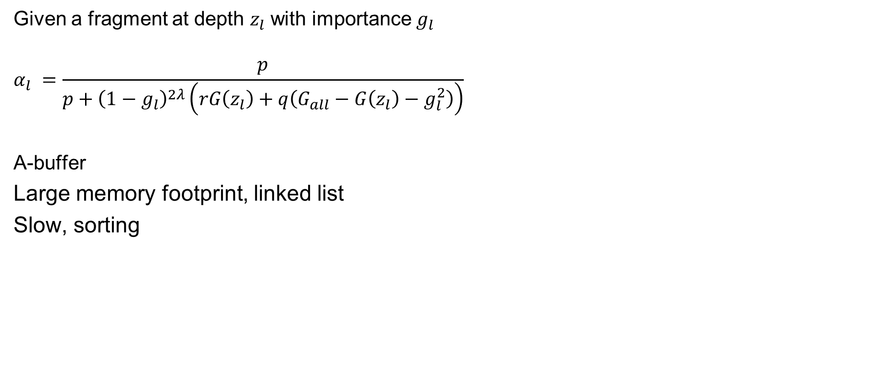
Decoupled Opacity Optimization (DOO)
Given a fragment at depth $z_{l}$ with importance $g_{l}$
$$α_{l} =\frac{p}{p+{\left(1−g_{l}\right)}^{2λ}\left(rG\left(z_{l}\right)+q\left(G_{all}−G\left(z_{l}\right)−g_{l}^{2}\right)\right)}$$
A-buffer
Large memory footprint, linked list
Slow, sorting
Notes:
An-Abuffer was a interesting way to solve decoupled opacity optimization problem in practice
With a buffer linked list we store with each fragment its corresponding importance value
Then, the linked list is sorted from front to back
And in the final rendering pass, optimized opacity value is evaluated per each fragment in order
However, Two main problems might arise with a buffer solution:
First, since we build a linked list per each pixel, this might lead to unbounded memory requirements for moderate or large datasets
Second, sorting the linked list incurs additional overhead, which make the technique in general slow

Slide 12
Object Space Filtering
Smooth opacity across adjacent segments
Additional data structures is implemented
Points, lines and surfaces are handled differently
Notes:
Now we come with another important step in DOO
Once we optimize the opacity per pixel, it might leads to discontinuities of the opacity along adjacent vertices
Opacity optimization solutions used to smooth the opacity value along the geometric structures
In order to do that,
First input geometry is divided into smaller geometric partitions
*As we se here a large line is divided into smaller line segments
*Then optimal opacity is stored per each segment
*And finally a Laplacian smoothing kernel is applied to each line to smooth opacity along neighbor segments
The object space filtering add additional overhead to the DOO technique:
In the beginning, we have to divide input structures into smaller partitions and maintain adjacency information,
specifically lines are divided into small line segments and surfaces are divided into small surface patches
and the filtering process has to handle lines and surfaces differently

Slide 13
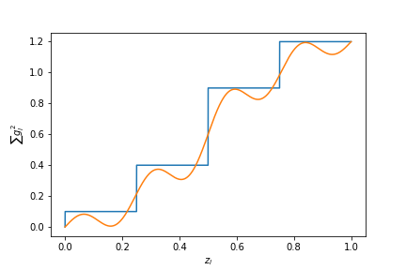
Fourier Opacity Optimization (FOO) [BGG19]
Use Fourier series of importance
Large memory gain, no linked list
Fast, no sorting
Truncated Fourier representation
Object space smoothing
Notes:
Very recently a Fourier based approach has been used for OO
In this work Baeza and colleagues replaced the accumulated importance along the view ray by a Fourier series approximation
As shown in this figure a Fourier series can be used to reconstruct accumulated importance along the view ray
The FOO technique has several advantages:
First, It is memory bound since we store few Fourier bands (in practice 4 to 5) into render target buffers,
By doing so, we get a big memory gain relative to the a-buffer implementation, since we use a fixed number of screen space textures to store Fourier coefficients instead of using dynamic lined list to store the importance
Second, we replace complicated linked list sorting by order independent Fourier signal reconstruction of accumulated importance along the view ray
However, FOO comes with several issues:
First, using truncated Fourier series for discrete signal representation might produces visual artifacts
Second, with FOO technique we sill have to perform object space filtering to smooth opacity values across adjected segments

Slide 14
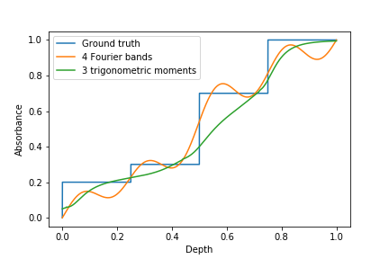
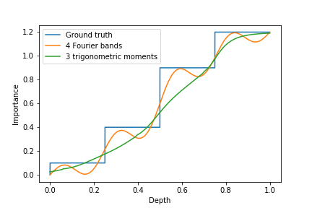
Moment-based Order Independent Transparency (MBOIT) [MKKP18]
Store transmittance as function of depth
Compact representation of transmittance
More efficient that Fourier opacity mapping
Notes:
So before I talk about our moment based approach for opacity optimization
I would like to talk about MBOIT technique presented in 2018
With MBOIT, Moments have ben used to compactly store absorbance signal along the view direction, and using a few number moments we are able to reconstruct original input signal in an efficient way
As show in the left figure moment based reconstruction has better representation than Fourier series of absorbance signal along the view ray and the reconstructed signal from moments does not suffer form ringing artifacts produces from truncated Fourier series reconstruction
MBOIT was proposed as improvement of the Fourier opacity mapping for OIT
And since FOO is based on Fourier opacity mapping we expect that moment based opacity optimization could be a viable improvement in the context OO
As show in these figures, we would like to highlight that both OIT and OO represents quite similar problems with two different signals and contexts

Slide 15
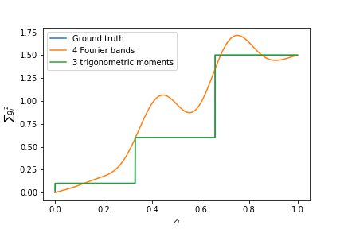
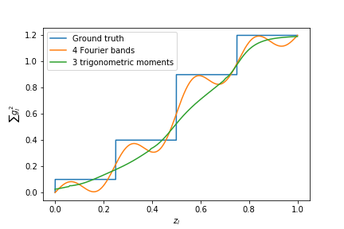
Discrete Signal Reconstruction
Notes:
To recap, let me highlight why would prefer moments rather than Fouriers for discrete signal representation and reconstruction
First, moment based reconstruction of discrete signal been shown to be highly accurate for sparse regions and also plausible for densely covered regions
Second, As we see in these two figures, and In contrast to a truncated Fourier series, moment based reconstruction does not suffer from severe ringing for large sparsely populated depth ranges

Slide 16
Moment-based Opacity Optimization (MBOO)
Motivation and Contributions
Novel technique for opacity optimization using moments
Efficient and fast filtering method for optimized opacities
Evaluate our technique against state of the art solutions
Notes:
Well, let me talk in detail about our moment based opacity optimization technique
And explain our main contributions in the next slides

Slide 17
Moment-based Opacity Optimization (MBOO)
Moments buffers
Filtered
moments buffers
Moments generation (g_{i})
Filtering moments buffers
Input geometry
Importance (gi)
Find α_{i}
Rendering
semi-transparent geometry
Final image
Input geometry
Notes:
In this diagram we show the main processing steps for our Moment based Opacity Optimization (MBOO) appraoch
Generally speaking, we use a rendering pass to accumulate importance into moments buffers
Then we replace object space smoothing with screen space filtering of moments buffers
And finally we substitute optimized opacity into final compositing pass

Slide 18
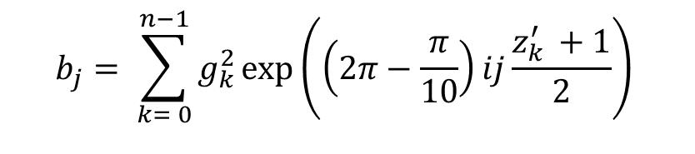
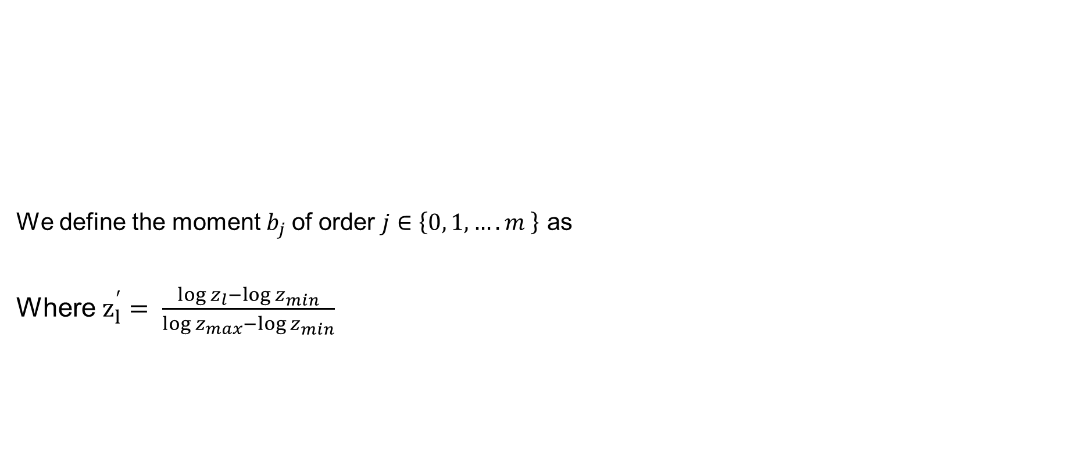
Moment Generation of Importance
Filtered
moments buffers
We define the moment $b_{j}$of order $j∈\left\{0, 1, ….m \right\}$ as
Where $z_{l}^{′}= \frac{\log{z_{l}−\log{z_{min}}}}{\log{z_{max}}−\log{z_{min}}}$
Moments buffers
Moments generation (g_{i})
Filtering moments buffers
Input geometry
Importance (gi)
Find α_{i}
Rendering
semi-transparent geometry
Final image
Input geometry
$$b_{j}= \sum_{k= 0}^{n−1}{g_{k}^{2}\exp\left(\left(2π−\frac{π}{10}\right)ij\frac{z_{k }^{′ }+1}{2}\right)}$$
Notes:
In the first step, we generate moments coefficients out of importance signal
So for a given a pixel with n fragments
We construct m order trigonometric moments out of importance and depth values using trigonometric moment generating function
We use additive blending to accumulate moments coefficients into render target buffers
In practice we use screen size float textures to store these coefficients
And since we are using 3 trigonometric moments in our implementation, we only need 7 float channels in total
Similar to moment based order independent transparency, and for efficient reconstruction we logarithmically warp the input depth range into a range of -1 to 1
For more details please look into our paper

Slide 19
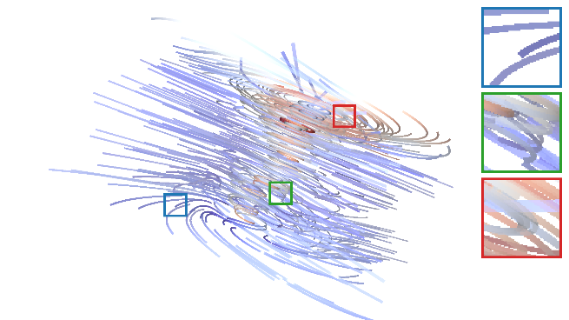
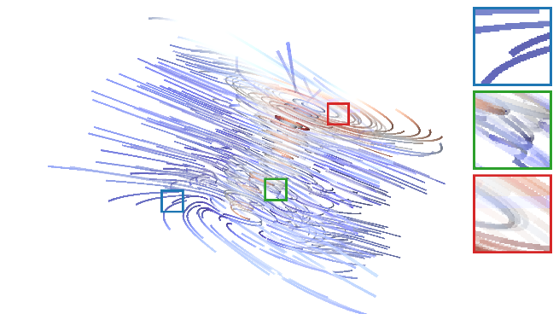
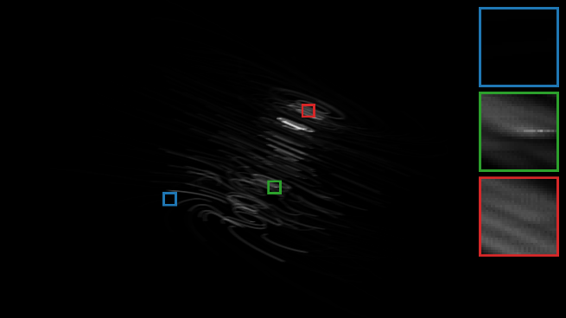
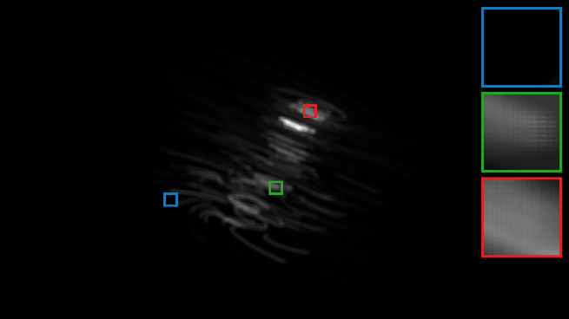
Screen Space Filtering
Filtered
moments buffers
Two-pass linear Gaussian blur
Moments buffers
Moments generation (g_{i})
Filtering moments buffers
Input geometry
Importance (gi)
Find α_{i}
Rendering
semi-transparent geometry
Final image
Input geometry
MBOO without filtering
MBOO with filtering
Notes:
As a second main contribution of work
we introduce a more general approach to smooth opacity along adjacent geometric fragments
Given that we store moments in sperate textures channels
We apply a two-pass Gaussian blur to each moment individually,
as shown in this figure we apply a gaussian kernel of width 21 pixels to the Tornado rendering
The bottom row show the zeros moment before and after screen space filtering
As we see with tornado streamlines, our approach achieves the core goal of filtering in opacity optimization by fading out clutter that
occlude important structures
Our filtering approach for optimized opacity offer several advantages than object space filtering introduced in previous work
In terms of processing
Our approach is relatively simple and fast, since in practice, we use screen filling quads to linearly filter moments textures in a ping pong fashion
And in terms of memory overhead our approach uses additional number textures channels as similar as the number of moments

Slide 20
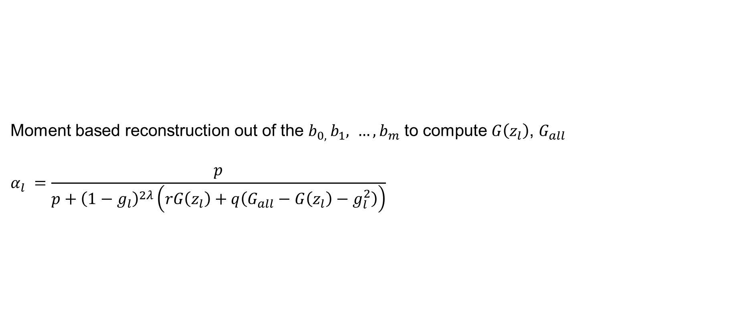
Opacity Optimization
Filtered
moments buffers
Moment based reconstruction out of the $b_{0, }b_{1}, …, b_{m}$ to compute $G\left(z_{l}\right)$, $G_{all}$
$$α_{l} =\frac{p}{p+{\left(1−g_{l}\right)}^{2λ}\left(rG\left(z_{l}\right)+q\left(G_{all}−G\left(z_{l}\right)−g_{l}^{2}\right)\right)}$$
Moments buffers
Moments generation (g_{i})
Filtering moments buffers
Input geometry
Importance (gi)
Find α_{i}
Rendering
semi-transparent geometry
Final image
Input geometry
Notes:
Once we filtered moment buffer, we use moment based reconstruction to approximate the accumulated importance for each rendered fragment
This step is not separate from the rendering step and can integrated into normal rendering pipeline
The only added complexity is that we bind moment textures as texture units in the renderer
then opacity value that comes from optimization equation is substituted for fragment opacity during final compositing

Slide 21
Rendering and Compositing
Filtered
moments buffers
Moment-based OIT
Two render passes
Construct moment buffers of transmittance
Accumulate the transmittance for final compositing
Moments buffers
Moments generation (g_{i})
Filtering moments buffers
Input geometry
Importance (gi)
Find α_{i}
Rendering
semi-transparent geometry
Final image
Input geometry
Notes:
Our OO method is compatible with any method for OIT
For final rendering and compositing
We favored moment based OIT for the fore mentioned reasons
For mboit rendering, we use two render passes
In the first pass we construct moment buffers of input transmittance
And in the second pass, we use additive blending to accumulate reconstructed transmittance out of moment buffers

Slide 22
Results and Evaluations
Our visualization framework uses OpenGL 4.4
All aspects are GPU-accelerated
Rasterization pipeline
Compute shaders
Use datasets of points, lines and arbitrary triangle meshes
Compare our MBOO approach against DOO and FOO
Notes:
Now, let me introduces the results and evaluations of our OO technique
Our visualization framework uses OpenGL 4.4
All aspects are GPU-accelerated
We use the rasterization pipeline for opacity optimization and rendering
We evaluate our technique on datasets of points, lines and arbitrary triangle meshes
And we compare our MBOO approach against DOO and FOO

Slide 23
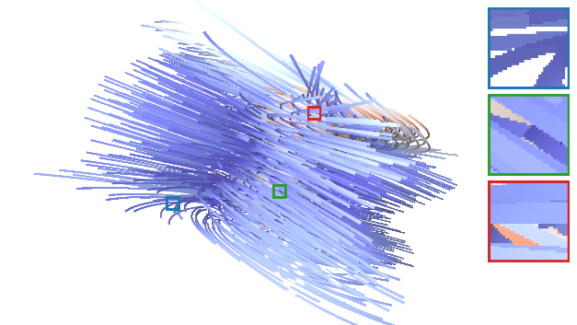
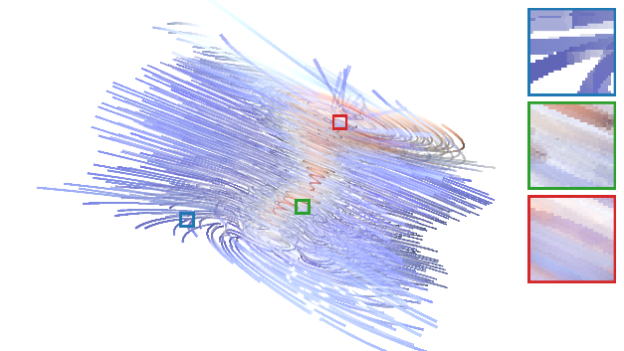
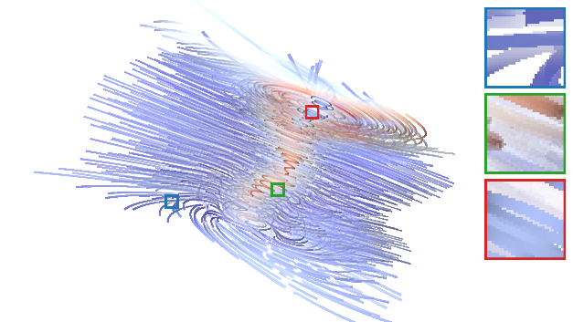
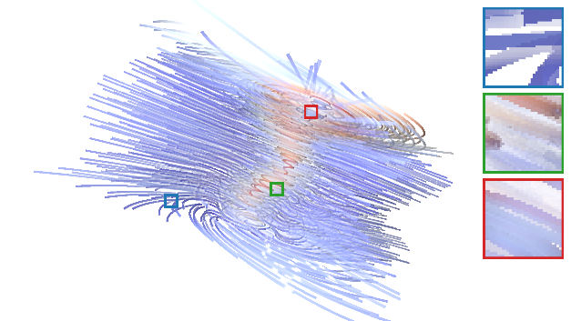
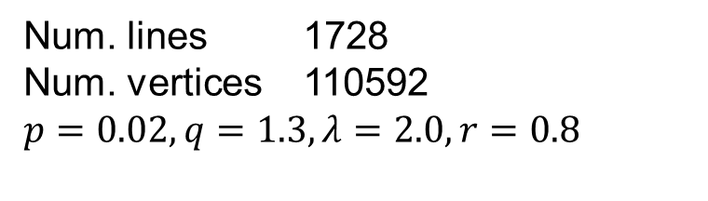
Tornado
OO disabled
DOO
FOO
MBOO (ours)
6.8 ms
12.0 ms
5.8 ms
5.6 ms
Num. lines 1728
Num. vertices 110592
$$p=0.02, q=1.3,λ=2.0, r=0.8$$
Notes:
We used streamlines of several datasets to compare the visual quality and rendering time of our technique against DOO and FOO
In the left most image we disable opacity optimization and used abuffer for rendering to convey the correct shape of input geometry and highlight clutter around important structures
For the second image we used analytic opacity optimization with abuffer implementation and used abuffer for rendering. in this experiment, we enabled object space filtering
In third image we used FOO with screen space filtering for OO and a Fourier based approach for oit
And in the right most image we used our moment based technique with screen space filtering for oo and used moit for rendering
In these settings, our approach provide quite similar results in terms of visual quality relative to both DOO and FOO
In terms of running time our technique has a relatively large gain in regard to DOO and has quit similar running time relative to FOO

Slide 24
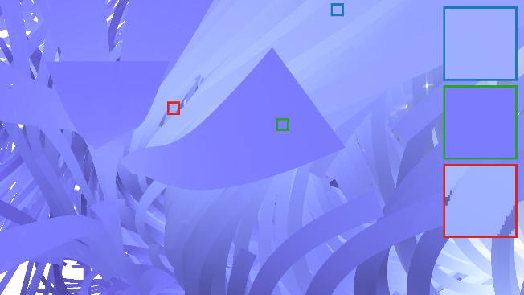
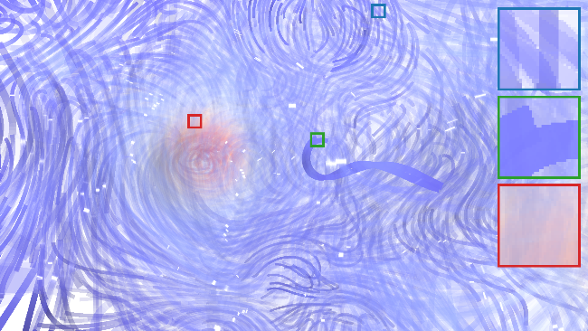
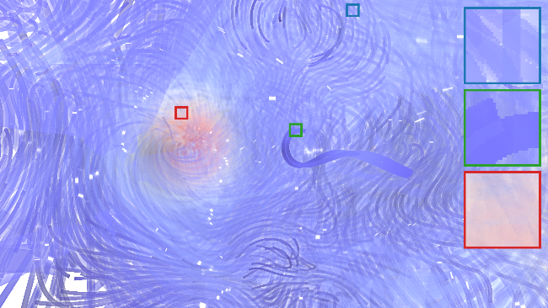
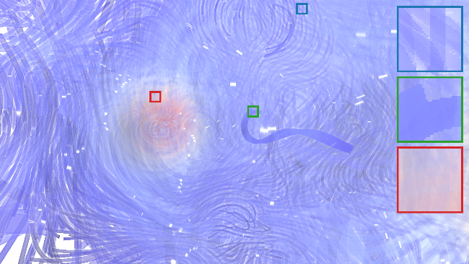
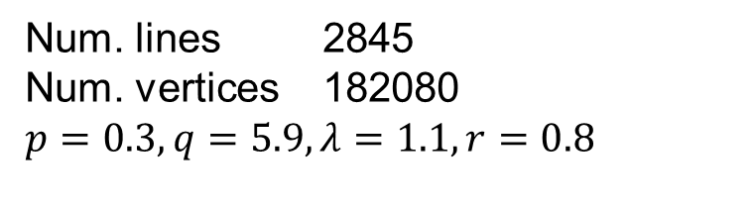
Borromean rings
OO disabled
DOO
FOO
MBOO (ours)
60.0 ms
100.0 ms
30.5 ms
26.9 ms
Num. lines 2845
Num. vertices 182080
$$p=0.3, q=5.9,λ=1.1, r=0.8$$
Notes:
The next dataset show the magnetic field lines in the decay of magnetic knots
We show a close-up of one of the two symmetric rings in this dataset, OO helps us to discover this ring structure behind foreground clutter
The discriminate visual differences between DOO at one side and FOO and MBOO at the other side, comes sine we used different filtering techniques
As we use object space filtering With DOO
And use screen space filtering with both MBOO and FOO
However as shown in the magnified insets, our filtering approach still successful in smoothing opacity along neighbor structures and decaying foreground clutter Infront of important structures

Slide 25
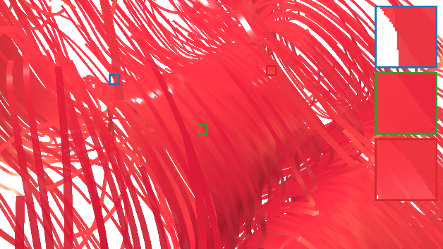
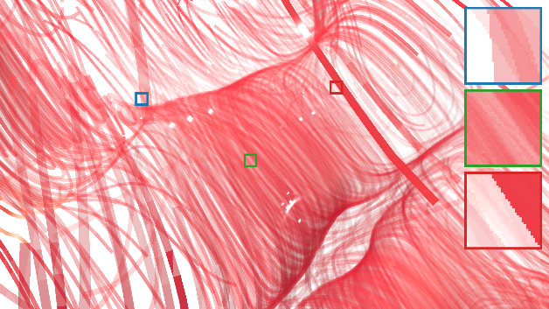
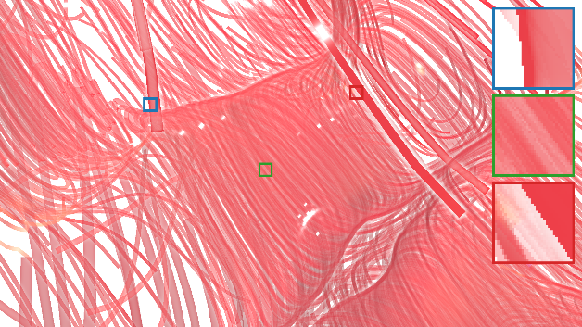
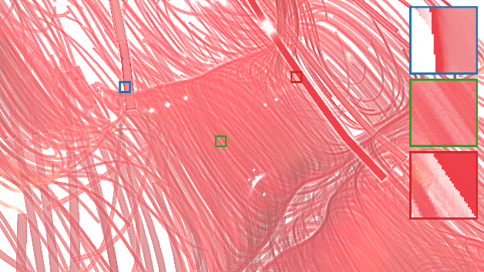
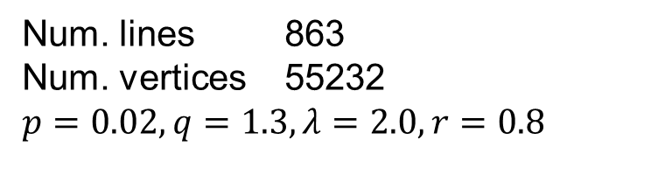
Rayleigh-Bénard convection
OO disabled
DOO
FOO
MBOO (ours)
25.5 ms
40.9 ms
7.9 ms
8.2 ms
Num. lines 863
Num. vertices 55232
$$p=0.02, q=1.3,λ=2.0, r=0.8$$
Notes:
This dataset highlight the Rayleigh-Bénard convection that comes when a thin layer of fluid is heated from below
OO achieves good viability for the resulting convection cells and keeps slower flows where they do not occlude important structures

Slide 26
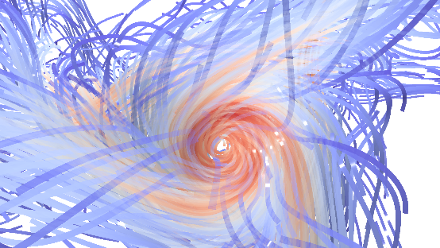
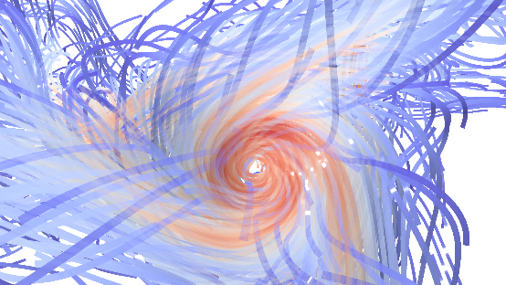

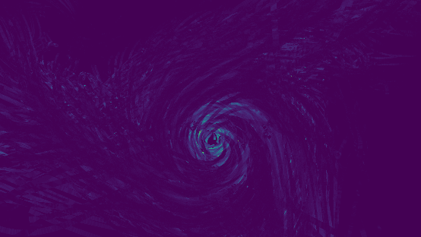
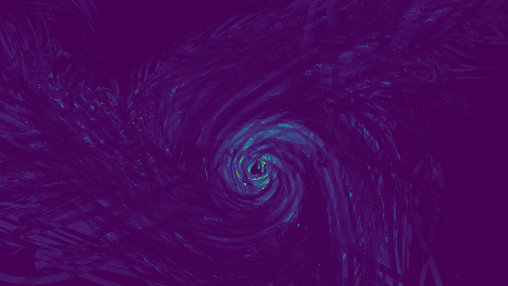
Screen Space Error
DOO
FOO
MBOO
Notes:
In this figure we show a visual validation of correctness of our techniques,
for this experiment we disabled object space filtering with DOO and disbaled screen space filtering with FOO and MBOO
Please keep in mind that since we disabled object space filtering in DOO, we optimize the opacity directly on fragment basis
We used abuffer for final compositing in order to separate the error that comes from our solution for opacity optimization using moments
As we see hre the visual differences between the reference solution using DOO is minimal against approximate solutions using FOO and MBOO
Using an error plot we can admit that our technique has slightly bigger error than FOO although it has little effect on the final visualization
The greatest errors occur in regions with important lines near unimportant lines and strong overdraw
however, Fourier opacity optimization uses nine coefficients, whereas our technique uses seven

Slide 27
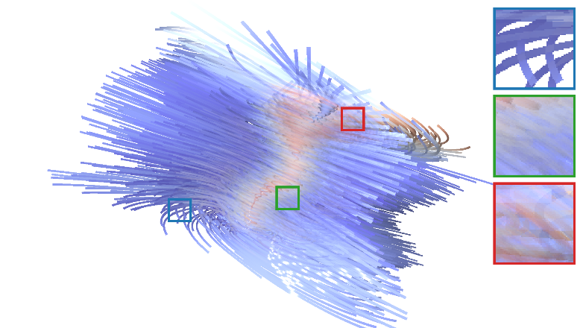
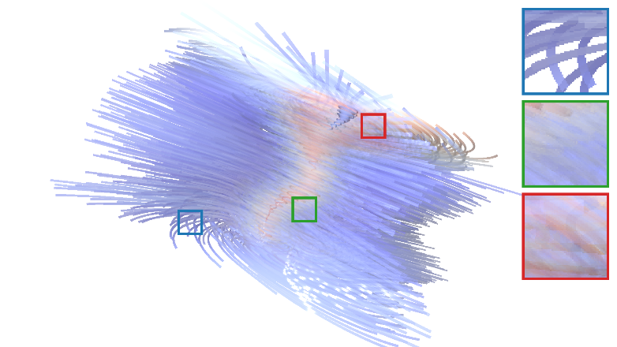
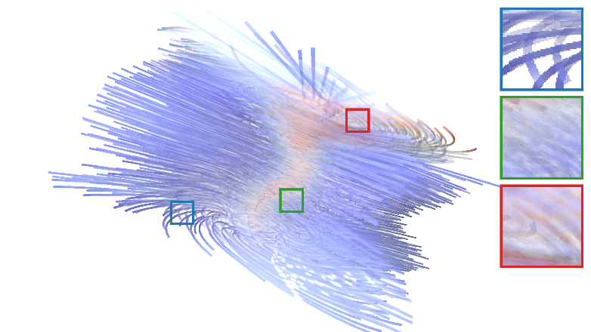
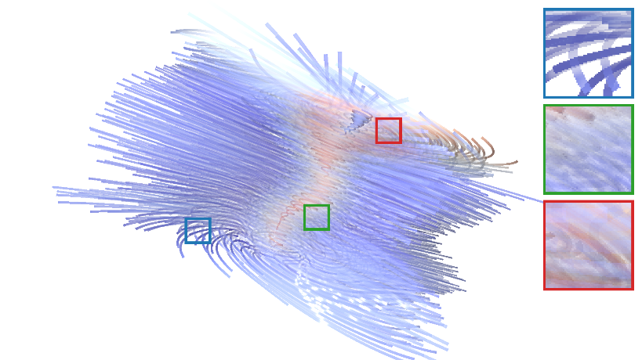
Screen Space Filtering
DOO without filtering
DOO with object space filtering
MBOO without filtering
MBOO with filtering
Notes:
In this figure we highlight the use of screen space filtering to remove clutter
In this regard, we compare DOO with object space filtering against MBOO with screen space filtering
Using 21x21 gaussian kernel for screen space filtering we achieve the core goal of filtering in region where un important clutter appears in front of important structures

Slide 28
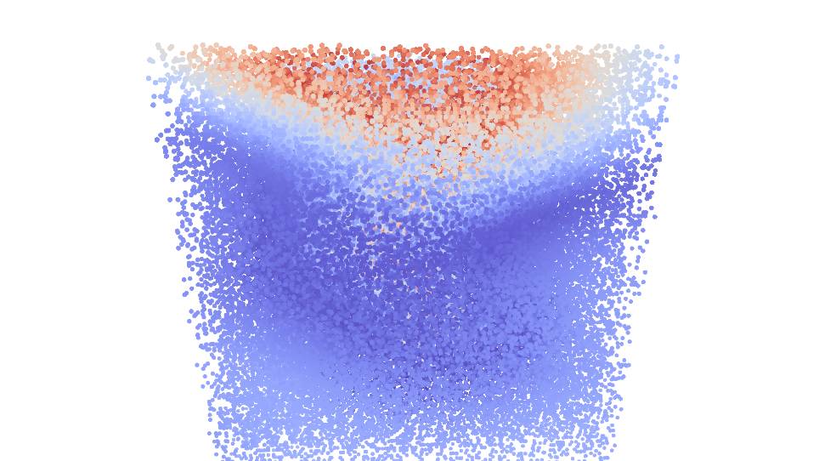
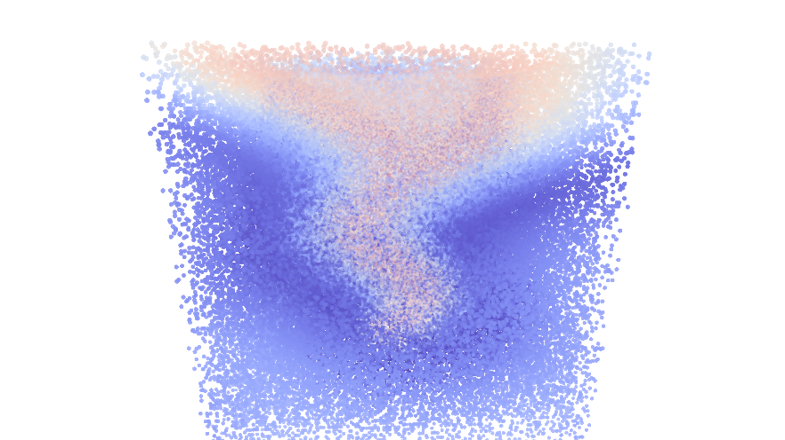
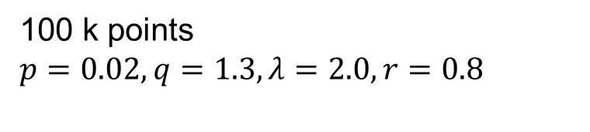
MBOO with Points
OO disabled
MBOO
100 k points
$$p=0.02, q=1.3,λ=2.0, r=0.8$$
Notes:
In this figure we use MBOO with points of tornado vector field
In this scenario we used velocity as an importance measure
opacity optimization helps us to detect the internal vortex structures in this point set

Slide 29
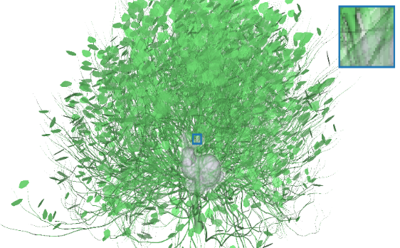



MBOO with Triangle Mesh
OO disabled
FOO
MBOO
Importance value 0.9 for bunny and 0.2 for bush
$$p=1.9, q=6.9,λ=1.0, r=1.2$$
Notes:
This experiment demonstrates a nice use case of our screen space filtering.
We use two triangle meshes with complicated topology
Using object space filtering with the bush structure is not trivial in this situation and would be difficult since the meshes are not designed with such requirements in mind
On the other hand our screen space filtering is trivially applicable without adding anything special to the implementation.
In this example the bunny has much high importance that the bush structures
And using OO with screen space we can discriminate the bunny behind frontal leaves structures

Slide 30
Conclusion
We presented an opacity optimization technique based on moments
Our techniques is faster and easier than DOO
Quality and speed is similar to FOO
Lower memory footprint
Screen space filtering decouples implementation of OO from geometric primitives
Future Work
Exploring automatic ways to find optimization parameters
Extending our approach into large datasets on multiple GPUs

Slide 31
Thanks for your attention ☺
Questions

